Slide 1
LONG-TERM FORECASTING OF ELECTRICITY LOAD DEMAND IN PANAMA
Final Project Report | Big Data Analytics
By Antony Garcia
Student ID: 901004615 | email; agarcia3@wpi.edu

Slide 2
Project description and objectives
Electricity load forecasting is considered a crucial task in the energy industry as it enables energy providers to optimize energy production and distribution, reduce energy costs, and improve energy efficiency. The objective of this project is to develop a long-term predictive model for electricity load forecasting using the "Short-term Electricity Load Forecasting (Panama)" dataset available on Kaggle.
The dataset, covering the period from 2015 to 2020, contains hourly load data, weather variables, holidays, and weekly load forecast features. With a resolution of one hour, this dataset provides an excellent opportunity to apply machine learning algorithms such as Recurrent Neural Networks (RNNs) and Long Short-Term Memory (LSTM) networks for long-term electricity load forecasting in Panama.
By forecasting the electricity demand for several years, this project aims to provide insights into the future electricity demand in Panama, which could help in better resource planning, management, and distribution.

Slide 3
Final Project Status Report
01. State of art review
02. Dataset inspection
In the field of load forecasting, time series analysis is a widely used approach
In this project, two datasets are being used: a power demand dataset and a weather dataset.
03. Data pre-processing
04. Feature analysis
05. What’s next?
In order to prepare the data for analysis, several pre-processing steps were taken
The correlation matrix was used to identify the most relevant features for the power demand prediction.
After feature analysis, the next step is usually to select and engineer the features that will be used for the prediction model.

Slide 4

State of art review
Load forecasting is an important problem in the field of energy management and has received significant attention in the literature. There are various methods for load forecasting, including statistical models, machine learning algorithms, and hybrid models.
Recent advances in deep learning, specifically in the area of recurrent neural networks (RNNs), have shown promising results in load forecasting. RNNs are particularly suited for time series data, as they can learn to model the temporal dependencies between data points.

Slide 5
State of art review
Reviewed papers:
R. K. Agrawal, F. Muchahary, and M. M. Tripathi, “Long term load forecasting with hourly predictions based on long-short-term-memory networks,” 2018 IEEE Texas Power and Energy Conference (TPEC), 2018.
H. Shi, M. Xu, and R. Li, “Deep learning for household load forecasting—a novel pooling deep RNN,” IEEE Transactions on Smart Grid, vol. 9, no. 5, pp. 5271–5280, 2018.
Jian Zheng, Cencen Xu, Ziang Zhang, and Xiaohua Li, “Electric load forecasting in smart grids using long-short-term-memory based recurrent neural network,” 2017 51st Annual Conference on Information Sciences and Systems (CISS), 2017.
Y. Wang, N. Zhang, and X. Chen, “A short-term residential load forecasting model based on LSTM recurrent neural network considering weather features,” Energies, vol. 14, no. 10, p. 2737, 2021.
H. Shi, M. Xu, and R. Li, “Deep learning for household load forecasting—a novel pooling deep RNN,” IEEE Transactions on Smart Grid, vol. 9, no. 5, pp. 5271–5280, 2018.

Slide 6
State of art review
Important takeaways from reviewed papers:
RNN and LSTM models have demonstrated superior performance in load forecasting compared to traditional statistical models.
The incorporation of weather data as an additional input feature has shown to significantly improve the accuracy of load forecasting.
Long-term load forecasting is a challenging task, but the use of LSTM models has shown to be effective in capturing long-term dependencies in the data.
The use of deep RNN models, such as the pooling deep RNN, has shown to further improve the accuracy of load forecasting by capturing complex temporal patterns in the data.
The performance of RNN and LSTM models can be affected by the quality and granularity of the input data, as well as the choice of hyperparameters and architecture design.

Slide 7
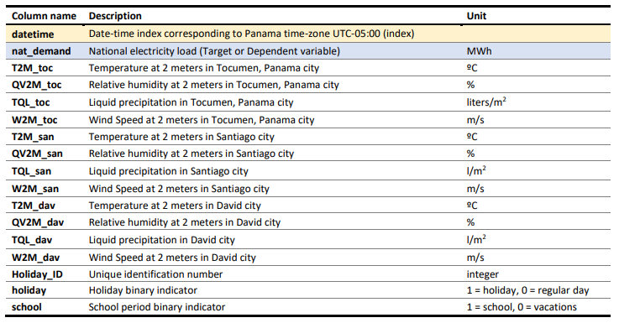
Dataset inspection
For this project "Short-term Electricity Load Forecasting (Panama)" dataset will be used. It is available for free in Kaggle.
This dataset contains the following information:
From this dataset only the nat_demand, holiday_id, holiday and school columns will be considered. The reason for this is that temperature, humidity and precipitation in Santiago and David cities may not be important for this study, as most of the power consumption in Panama takes place in Panama City, the Capital of the country.

Slide 8
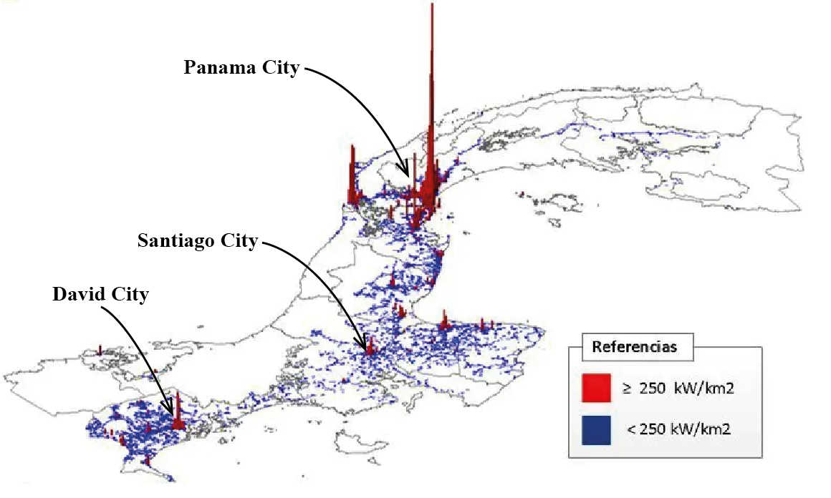
Dataset inspection
Santiago and David were excluded from the analysis due to their relatively low power consumption compared to Panama City.
In addition, the temperature readings for Panama City were taken in Tocumen, which is located approximately 25 miles away from the city center. Therefore, these columns will not be taken into account for this study.

Slide 9
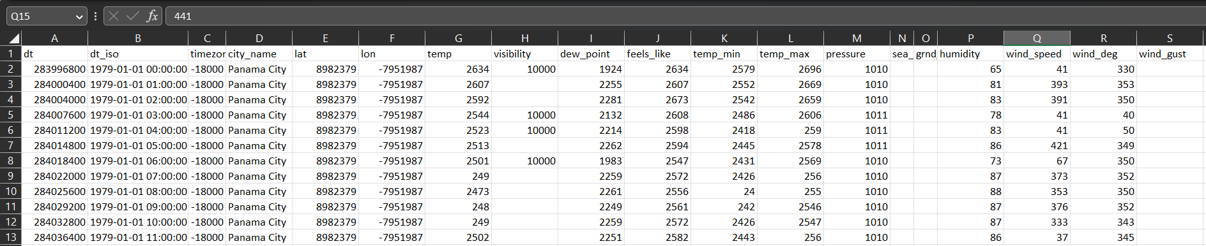
Dataset inspection
A distinct weather dataset was procured from OpenWeatherMap instead of utilizing weather data from the "Short-term Electricity Load Forecasting (Panama)" dataset. This distinct dataset comprises hourly weather data in Panama City from 1980 onwards.

Slide 10
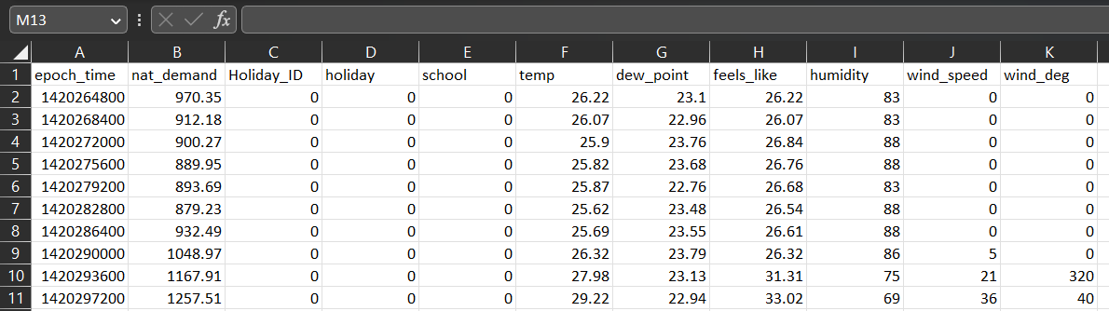
Dataset pre-processing
Python was used to pre-process the two datasets, load and weather, to make them appropriate for the proposed analysis. Normalizing was carried out on the temperatures, humidity, wind speed, dew point, perceived temperature, and national load to the same format, as decimal point numbers with two decimal places. The time of each sample was transformed into epoch format, which is a long integer representing seconds count since 1970, and this conversion will be helpful when using machine learning algorithms. Both datasets were merged into a single CSV file containing hourly load and weather data from 01/01/2015 to 06/27/2020.

Slide 11
Feature analysis
In load forecasting, selecting relevant features can have a significant impact on the accuracy of the model. The correlation matrix is a useful tool for identifying which features have the strongest linear relationship with the target variable (in this case, power demand).
The correlation matrix is a square matrix that shows the correlation coefficients between each pair of variables in the dataset. The correlation coefficient is a statistical measure that indicates the strength and direction of the linear relationship between two variables. A correlation coefficient of 1 indicates a perfect positive linear relationship, a coefficient of 0 indicates no linear relationship, and a coefficient of -1 indicates a perfect negative linear relationship.
By examining the correlation matrix, it is possible to identify the features that have the strongest linear relationship with the target variable. These features can then be selected for use in the forecasting model. However, it is important to note that the correlation matrix only captures linear relationships, and there may be other non-linear relationships between features and the target variable that are not captured by this method.

Slide 12
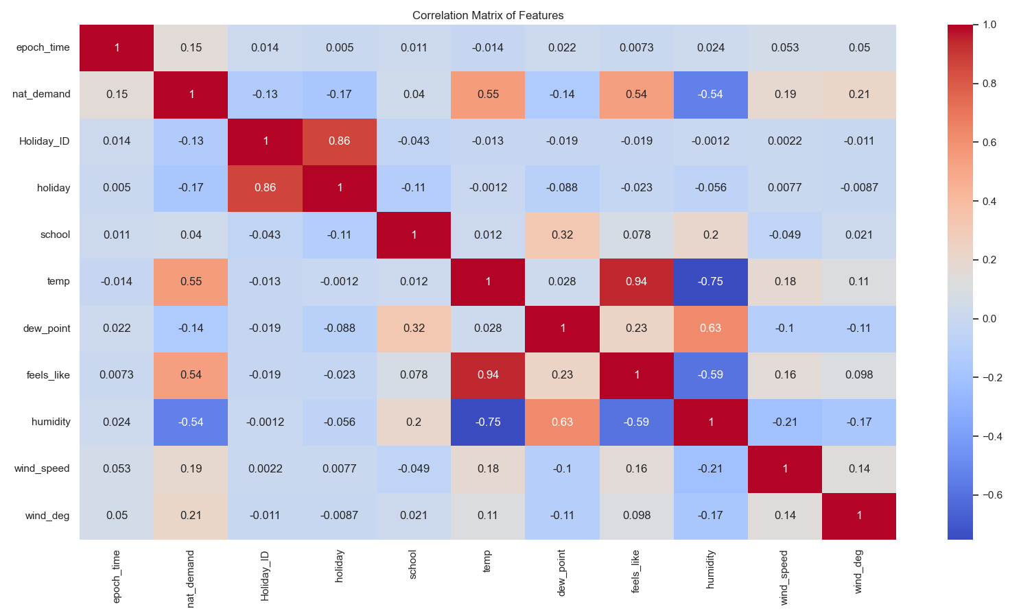
Feature analysis
A correlation analysis was performed over the dataset, which resulted in the following chart:
The correlation chart confirms that nat_demand is strongly correlated with temperature and humidity, which aligns with our expectations. Given that Panama has a hot and humid climate, air conditioning units are prevalent in most homes, significantly impacting the national load.
Conversely, time and the “school” column exhibit the weakest correlation with demand, as expected for a static analysis rather than a time series analysis.

Slide 13
Feature analysis
The impact of national holidays on the load cannot be overlooked as there are no public offices operating on such days, and all public office buildings in Panama use air conditioning units.
The feature analysis was conducted using Scikit Learn in Python.

Slide 14
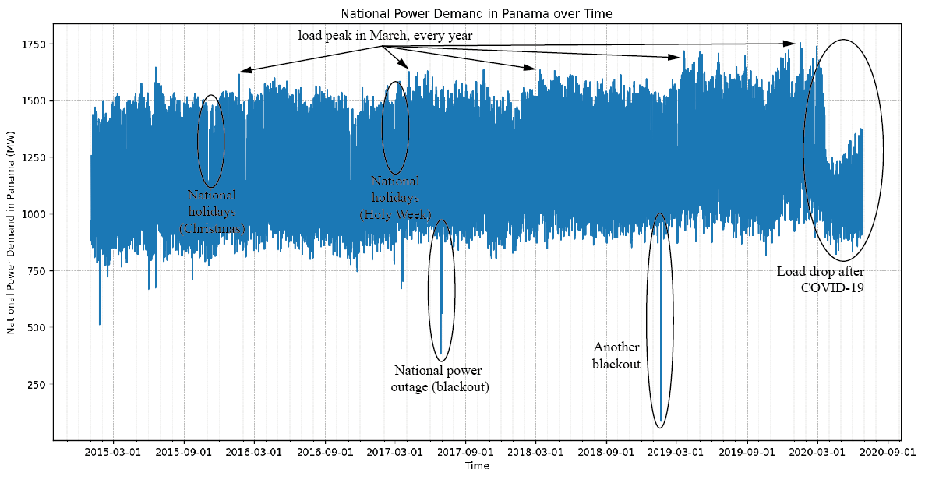
Feature analysis
There are some very interesting holiday and weather related behaviour in Panama as seen in the load over time chart:
There is a load peak every year in March, in the middle of dry season, where temperature is higher and wind stops.

Slide 15
Feature analysis
Every year during Christmas and Holy Week, there is a drop in the load. Holy Week takes place in March or April and includes a holiday on Thursday and Friday. These holidays are religious in nature.

Slide 16
Feature analysis
Two instances of "blackout" events occurred during this period, where the entire power grid went down. It is necessary to filter out these events to prevent statistical noise.

Slide 17
Feature analysis
At the onset of the COVID-19 quarantine, the power consumption of the entire country experienced a significant decrease as all public offices ceased operations. Given the abnormality of this situation, this particular time period should be excluded from the analysis.

Slide 18
What’s next?
✓ Develop a model plan for long term load forecasting, including selection of appropriate machine learning algorithms and hyperparameter tuning.
✓ Implement the selected machine learning algorithms for load forecasting.
✓ Evaluate the performance of the models using appropriate metrics.
✓ Finalize the machine learning models for load forecasting.
✓ Make predictions for the last couple of years and evaluate the model's performance.
✓ Communicate results through a technical report detailing the methodology, results, and conclusions of the project.
✓ Develop recommendations for potential strategies for operationalizing the load forecasting models.

Slide 19

Thanks

